Slide 1


The Impact of CPS Travel Time on Safety Assessments. Team Donett Huggins Office of Special Investigations

Slide 2
The OSI STEP team learned that centralization impacts safety assessment. The geo-map shows the caseload distribution for OSI. In looking at subsets of 2016 data it illustrates how travel affects safety assessment.
THE CHALLENGE: WHAT DATA TELL US

Slide 3
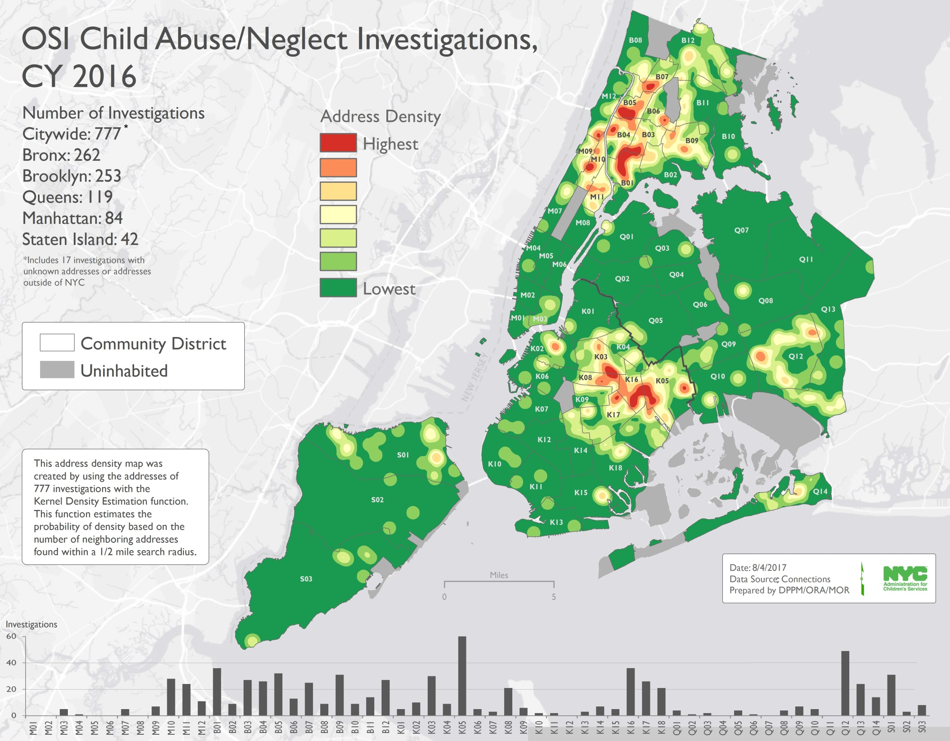
OSI Chid Abuse/Neglect Investigation CY 2016

Slide 4
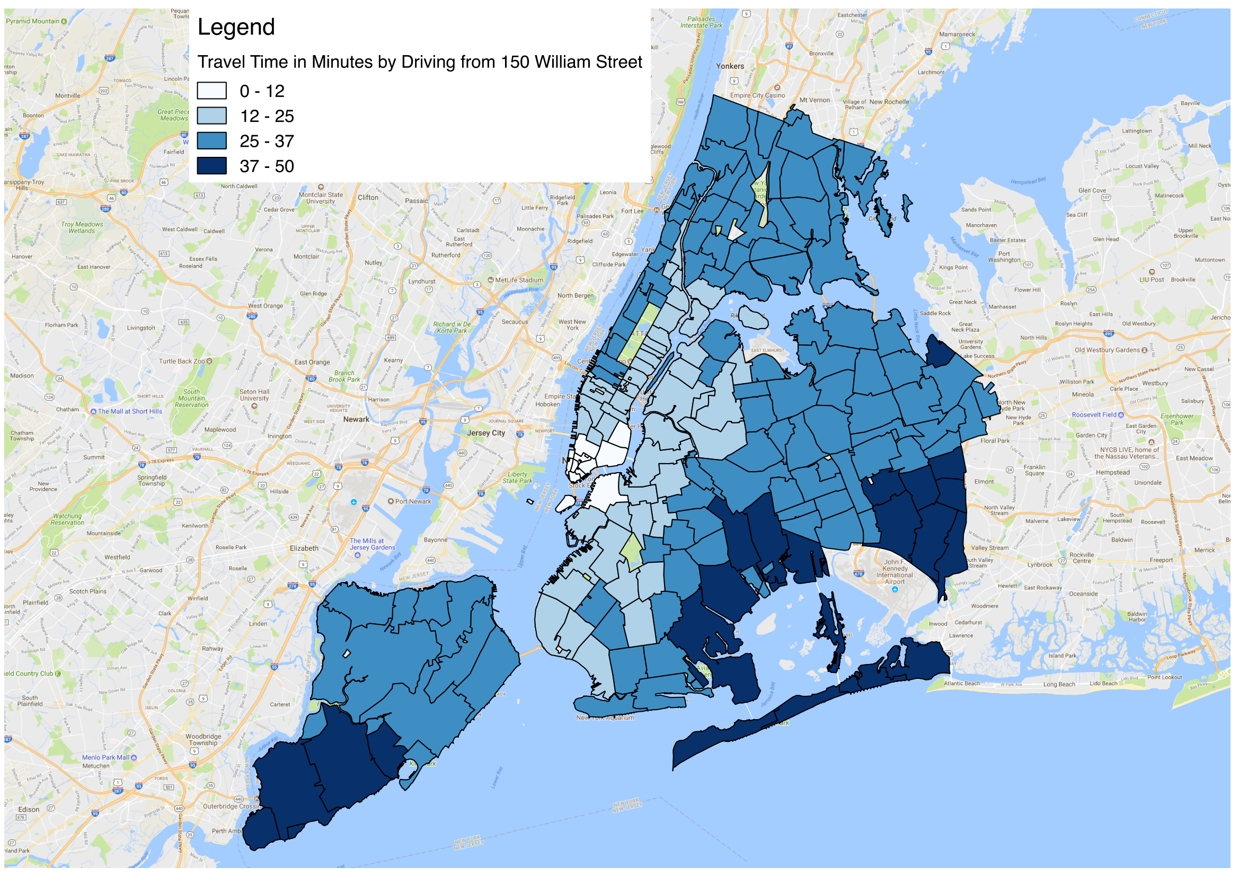
Travel Time in Minutes by Driving

Slide 5
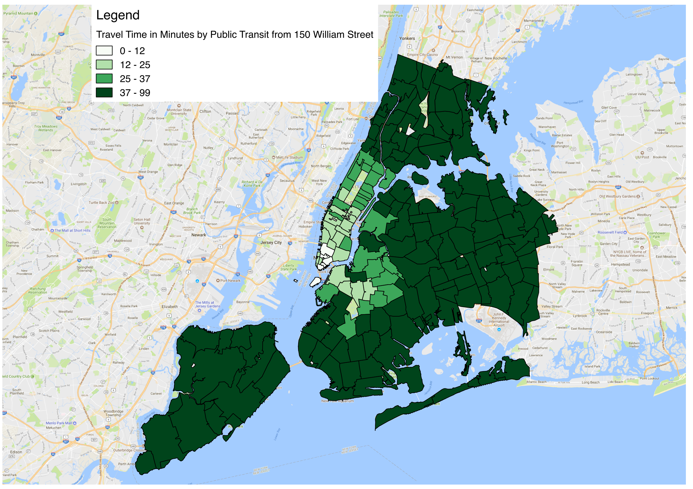
Travel by Public Transit

Slide 6
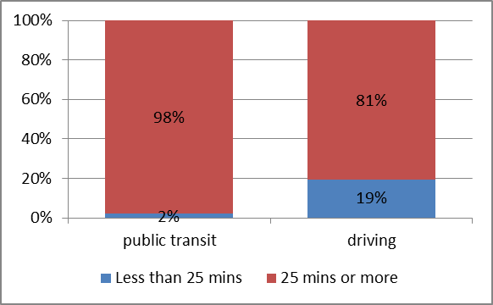

Slide 7
The OSI STEP team believes that the research will show how travel time negatively impacts the CPS staff ability to complete adequate safety assessment
SOLUTIONS: WHAT RESEARCH INDICATES

Slide 8
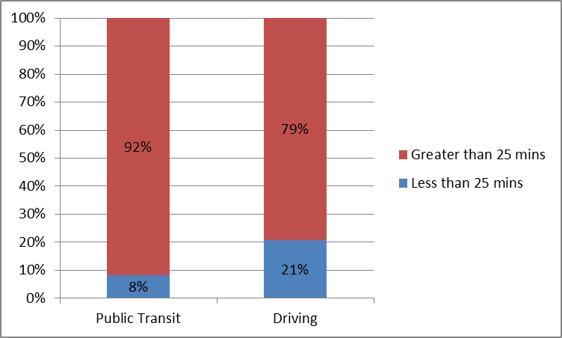

Slide 9
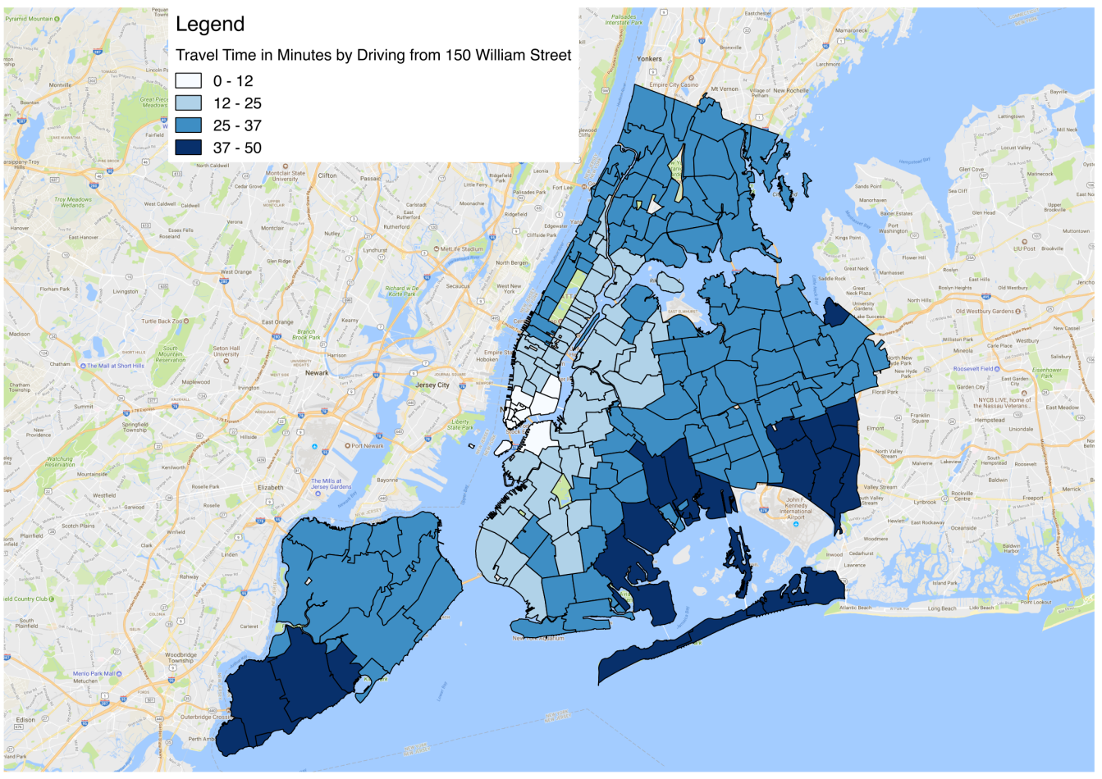
HYPOTHESIS
Data will show (new info) that by reducing the amount of time that OSI staff spends on travel to different boroughs, then safety assessments and outcomes (reduction in repeat maltreatment) will improve.

Slide 10
INNOVATION ACTIVITIES
Area: Brooklyn West Zone G and Bronx South Zone F.
-Review data on families and Family Services
-Conduct Case Reviews
-Assess collaboration between Family Service Unit and Preventive
-Make recommendations to leadership for next steps based on best practice

Slide 11
Evaluating Progress

Slide 12
Learn More
NYC Data Leader Innovation Team Isiaka Oyesile, Child Protection Manager
isiaka.oyesile@acs.nyc.gov
Brooklyn West Family Service Unit David Reznik, Child Protection Manager Bronx South Administration
David.Reznik@acs.nyc

